Slide 1
Stock and Work Order Analysis
Using MYSQL SERVER
Project: 2
by
Niraja P G

Slide 2
Summary
Objective:
To analyze stock and work order data by calculating and reporting on stock counts, work orders, pending statuses, and generating combined reports from multiple datasets.
Datasets:
Order Status:
Contains details about the status of each order.
Date_wise_supplier:
Contains information on suppliers and the quantities of orders
placed over time.

Slide 3
Instructions:
1. Calculate Stock Count and Work Order Count Based on Order ID.
2. Calculate Work Order Pending Status.
3. Close the Work Order.
4. Create New Table for Pending Status.
5. Create Second Table Using Join.
6. Date-wise Quantity and Order ID Count.
7. Split Supplier Names.
8. Stored Procedure and Export.

Slide 4
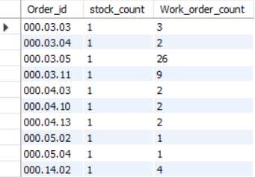
1. Calculate Stock Count and Work Order Count Based on Order ID
This query extracts order type counts, identifying how many entries are classified as "stock" and how many as "work order".
Syntax:
SELECT Order_id ,
count(if(Order_type = 'stock','1',Null)) AS stock_count ,
count(if( order_type ='Work_order','1',Null))AS Work_order_count FROM order_status
GROUP BY Order_id;
Output:
Conclusion:
This query provides insights into the distribution of order types for each order ID, helping to understand whether the focus is more on stock orders or work orders.

Slide 5
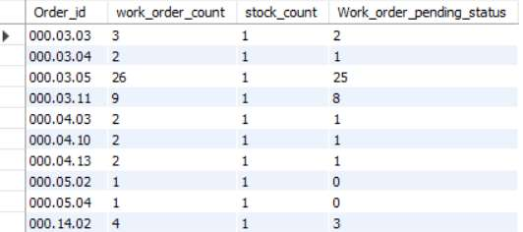
2. Calculate Work Order Pending Status This query computes the pending status by subtracting the work order count from the stock count.
Syntax:
SELECT Order_id, work_order_count ,stock_count, (work_order_count - stock_count) AS Work_order_pending_status
From
(SELECT Order_id,
count(if(Order_type = 'stock','1',Null)) AS stock_count , count(if( order_type ='Work_order','1',Null))AS Work_order_count
FROM order_status GROUP BY Order_id) AS Counts;
Output:
Conclusion:
By determining the difference between stock and work order counts, this query highlights how many work orders are still pending, which is crucial for managing inventory and planning production

Slide 6
3. Close the Work Order This query creates a new field `work_order_closed_or_not` based on whether the `work_order_pending_status` is less than 0.
Syntax:
SELECT order_id, work_order_count, stock_count, work_order_pending_status,
CASE
WHEN work_order_pending_status > 0 THEN 'Order_pending’
ELSE 'Order_closed’
END AS work_order_closed_or_not
From
(SELECT Order_id, work_order_count ,stock_count, (work_order_count - stock_count)
AS Work_order_pending_status
From
(SELECT Order_id,count(if(Order_type = 'stock','1',Null)) AS stock_count ,
count(if( order_type ='Work_order','1',Null))AS Work_order_count
FROM order_status
GROUP BY Order_id) AS Counts) AS OS_Status;

Slide 7
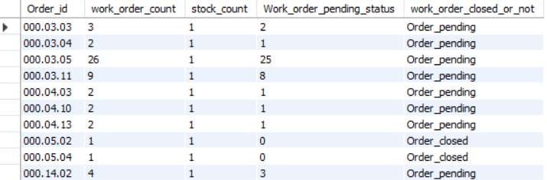
Output:
Conclusion:
This query indicates the status of each work order, showing whether it is closed or still pending. It helps in quickly assessing which orders need further attention or action.

Slide 8
4. Create New Table for Order Pending Status This query creates a new table and populates it with the results of the previous query.
Syntax:
CREATE TABLE Order_pending_status AS
SELECT order_id, work_order_count, stock_count, work_order_pending_status,
CASE
WHEN work_order_pending_status < 0 THEN 'Order_closed’
ELSE 'Order_pending’
END AS work_order_closed_or_not
From
(SELECT Order_id, work_order_count ,stock_count, (work_order_count - stock_count) AS Work_order_pending_status
From
(SELECT Order_id, count(if(Order_type = 'stock','1',Null)) AS stock_count ,
count(if( order_type ='Work_order','1',Null))AS Work_order_count
FROM order_status GROUP BY Order_id) AS Counts) AS OS_Status;
To View the Created Table:
SELECT * FROM Order_pending_status;
Conclusion:
The creation of a new table with pending statuses allows for easier tracking and management of work orders. It provides a streamlined view of order statuses, facilitating quicker decision-making.

Slide 9
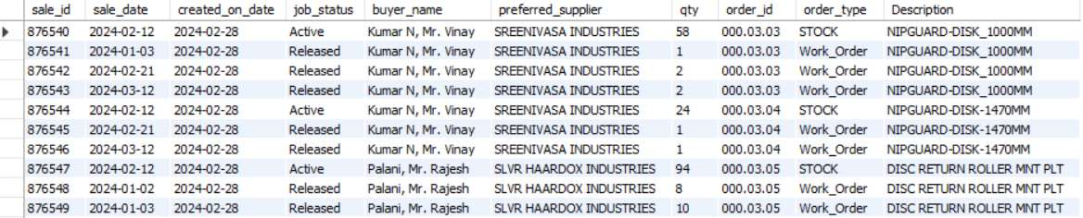
5. Create Second Table Using Join This query joins `Order_Status` and `Date_wise_supplier` on the common key.
Syntax:
CREATE TABLE order_supplier_report AS SELECT dws.sale_id,dws.sale_date, dws.created_on_date, dws.job_status, dws.buyer_name, dws.preferred_supplier, dws.qty, os.order_id, os.order_type , Os.DescriptionFROM Order_Status os JOIN date_wise_report dws ON os.sale_id = dws.sale_id;
To View the Table: SELECT * FROM order_supplier_report;
Output:
Conclusion:
This query combines order and supplier information, providing a comprehensive view of orders and their related supplier data. It is valuable for supply chain analysis and vendor management.

Slide 10
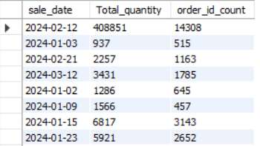
6. Date-wise Quantity and Order ID Count This query calculates total quantity and count of order IDs for each date.
Syntax:
SELECT sale_date, SUM(qty) AS Total_quantity, COUNT(order_id) AS order_id_count FROM order_supplier_report GROUP BY sale_date;
Output:
Conclusion:
This query offers insights into daily order volumes and the number of distinct orders. It can help identify peak order days and assist in resource allocation and forecasting.

Slide 11
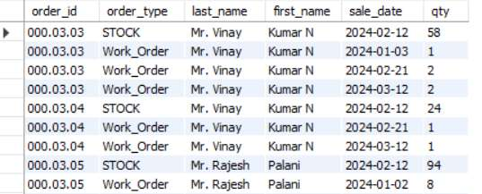
7. Split Supplier Names This query separates the supplier names by the comma delimiter.
Syntax:
SELECT order_id, order_type, SUBSTRING_INDEX(buyer_name, ',', -1) AS last_name,
SUBSTRING_INDEX(buyer_name, ',', 1) AS first_name, sale_date, qtyFROM order_supplier_report;
Output:
Conclusion:
By splitting supplier names into first and last names, this query allows for better data organization and improved communication with suppliers. It aids in creating more personalized supplier interactions.

Slide 12
8. Stored Procedure and Export This stored procedure executes the required queries and exports the results.
Syntax:
DELIMITER ##
CREATE PROCEDURE project2()
BEGIN
SELECT Order_id , count(if(Order_type = 'stock','1',Null)) AS stock_count , count(if( order_type ='Work_order','1',Null))AS Work_order_count FROM order_status GROUP BY Order_id;
SELECT Order_id, work_order_count ,stock_count, (work_order_count - stock_count) AS Work_order_pending_status From (SELECT Order_id,count(if(Order_type = 'stock','1',Null)) AS stock_count , count(if( order_type ='Work_order','1',Null))AS Work_order_count FROM order_status GROUP BY Order_id) AS Counts;
SELECT order_id, work_order_count, stock_count, work_order_pending_status,
CASE
WHEN work_order_pending_status > 0 THEN 'Order_closed’
ELSE 'Order_pending’
END AS work_order_closed_or_not From (SELECT Order_id, work_order_count ,stock_count, (work_order_count - stock_count) AS Work_order_pending_status From (SELECT Order_id,count(if(Order_type = 'stock','1',Null)) AS stock_count , count(if( order_type ='Work_order','1',Null))AS Work_order_count FROM order_status GROUP BY Order_id) AS Counts) AS OS_Status;

Slide 13
SELECT dws.sale_id,dws.sale_date, dws.created_on_date, dws.job_status, dws.buyer_name, dws.preferred_supplier, dws.qty, os.order_id, os.order_type , Os.DescriptionFROM Order_Status os JOIN date_wise_report dws ON os.sale_id = dws.sale_id;
SELECT sale_date, SUM(qty) AS Total_quantity, COUNT(order_id) AS order_id_countFROM order_supplier_report GROUP BY sale_date;
SELECT order_id, order_type, SUBSTRING_INDEX(buyer_name, ',', -1) AS last_name, SUBSTRING_INDEX(buyer_name, ',', 1) AS first_name, sale_date, qty FROM order_supplier_report;END
##DELIMITER ;
To View the procedure: CALL project2()
Conclusion:
This stored procedure automates the generation of order status and supplier report tables, ensuring that the latest data is always available for analysis. It simplifies the process of maintaining up-to-date reports for decision-makers.

Slide 14
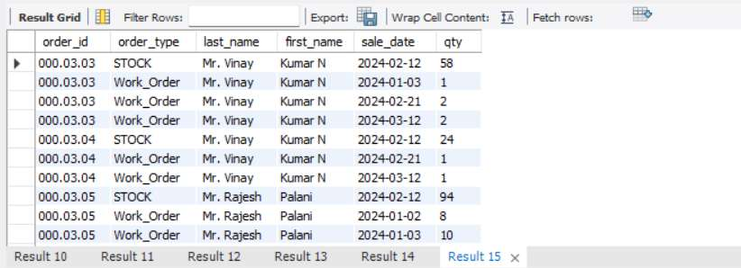
Output:
Export Reports:
Export all reports for reference.

Slide 15
Conclusion
The project involves a series of data processing tasks to analyze stock and work order statuses. Key steps include calculating stock and work order counts, determining pending statuses, creating and managing new tables, and generating detailed reports.
Steps to Completion:
Data Calculation
Update Status Field
Table Creation
Reporting
Storage and Export

Slide 16
Thank You

